Slide 1
Lecture 7
Lagrange Interpolation

Slide 2
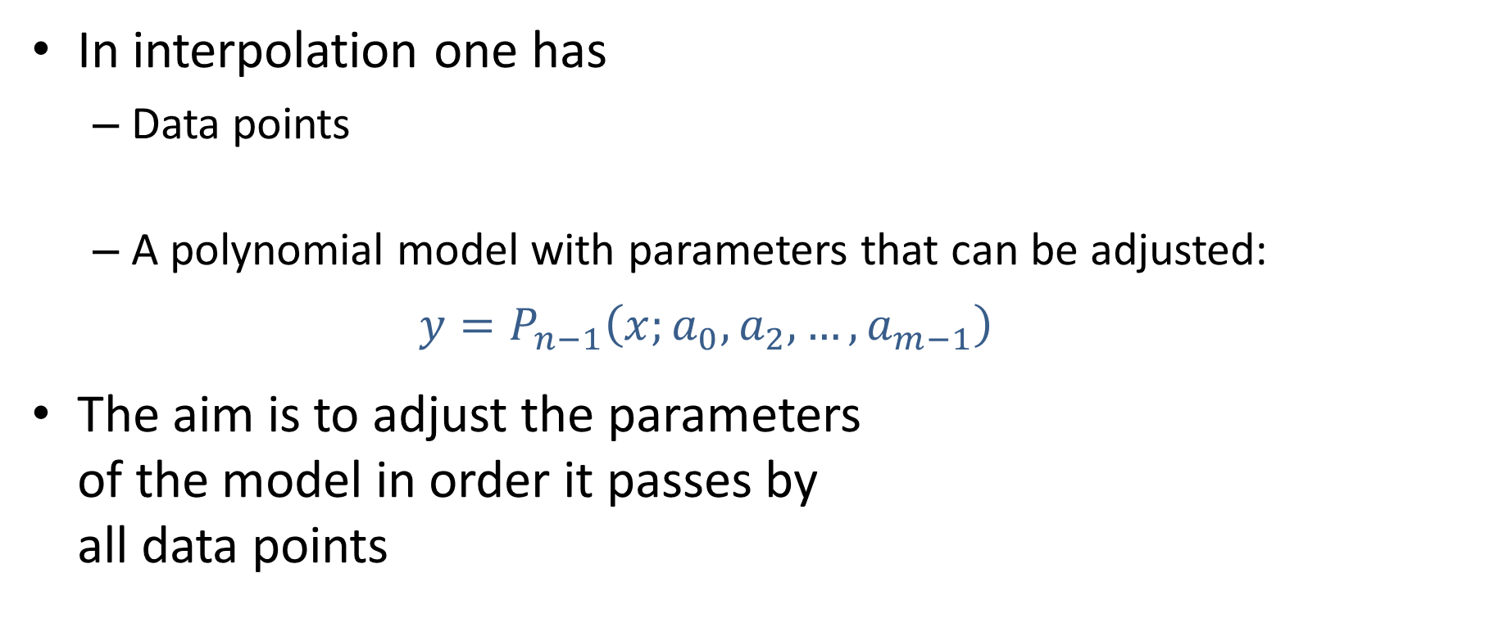


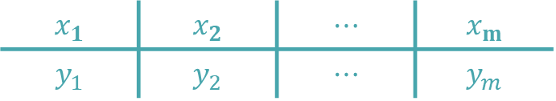
Overview of Lagrange Interpolation
In interpolation one has
Data points
A polynomial model with parameters that can be adjusted: $y=P_{n−1}\left(x;a_{0},a_{2},…,a_{m−1}\right)$
The aim is to adjust the parameters of the model in order it passes by all data points
$$x_{1}$$ | $$x_{2}$$ | $$⋯$$ | $$x_{m}$$
$$y_{1}$$ | $$y_{2}$$ | $$⋯$$ | $$y_{m}$$
$$y_{i}$$
$$x_{i}$$
Notes:
In this lecture we will discuss a third method to solve polynomial interpolation problems
As in the two previous methods we have a data set and our interpolating polynomial
Our aim is to choose the n parameters of the interpolating polynomial such that it passes exactly by all data points

Slide 3
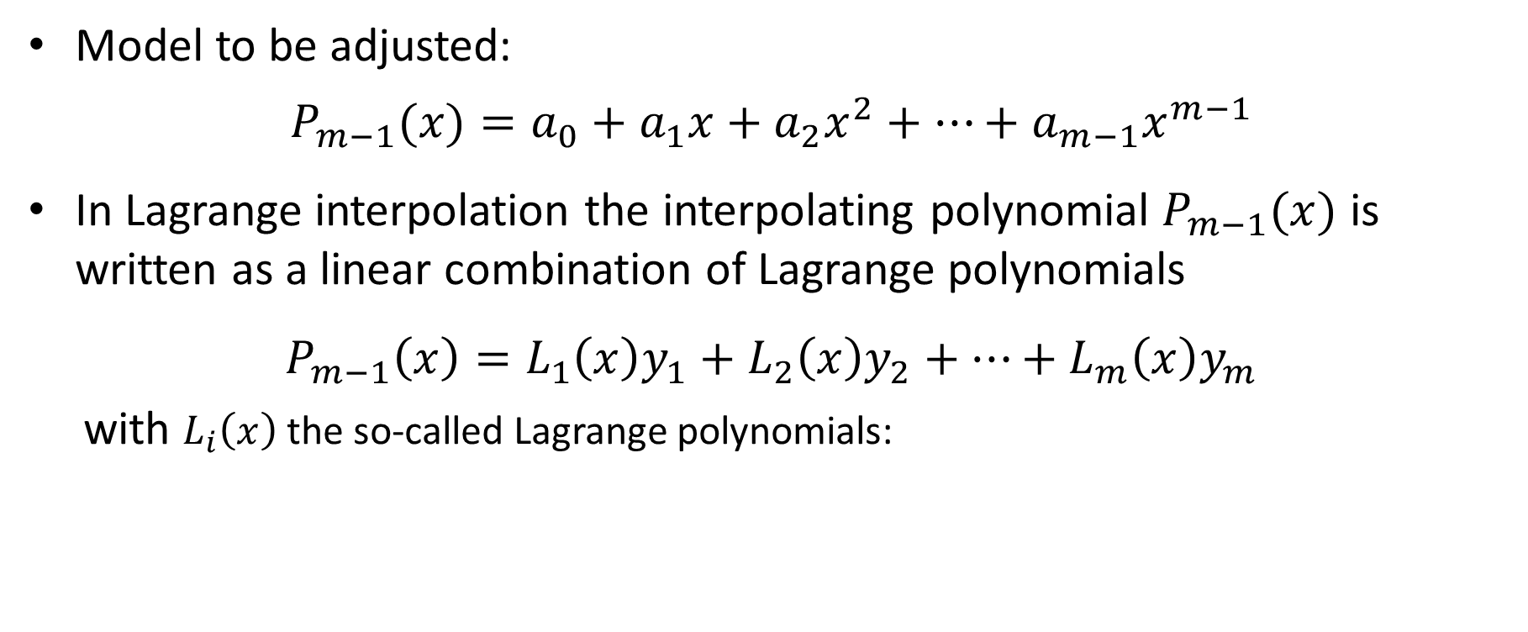



Lagrange Interpolation
Model to be adjusted:
$${P_{m−1}(x)=a}_{0}+a_{1}x+a_{2}x^{2}+…+a_{m−1}x^{m−1}$$
In Lagrange interpolation the interpolating polynomial $P_{m−1}(x)$ is written as a linear combination of Lagrange polynomials
$$P_{m−1}\left(x\right)=L_{1}\left(x\right)y_{1}+L_{2}\left(x\right)y_{2}+…+L_{m}\left(x\right)y_{m}$$
with $L_{i}\left(x\right)$ the so-called Lagrange polynomials:
$$L_{i}\left(x\right)=\left\{\begin{aligned}1, \\ &0, \end{aligned}\right.$$
$$x=x_{i}$$
$$x=x_{j} \text{for} j≠i$$
Notes:
As we have n data points, our interpolating polynomial is of degree n-1
The idea behind Lagrange interpolation is to write the interpolating polynomial as a linear combination of so-called Lagrange polynomials Li(x).
Written explicitly we obtain
$$P_{m−1}\left(x\right)=L_{1}\left(x\right)y_{1}+L_{2}\left(x\right)y_{2}+…+L_{n}\left(x\right)y_{m}$$
The Lagrange polynomials Li(x) satisfy a very particular condition
When evaluated in the interpolating points they evaluate either to one or zero
More precisely the Lagrange polynomial Li(x) evaluates to one for x=xi, and will evaluate to zero for all other interpolating points.

Slide 4
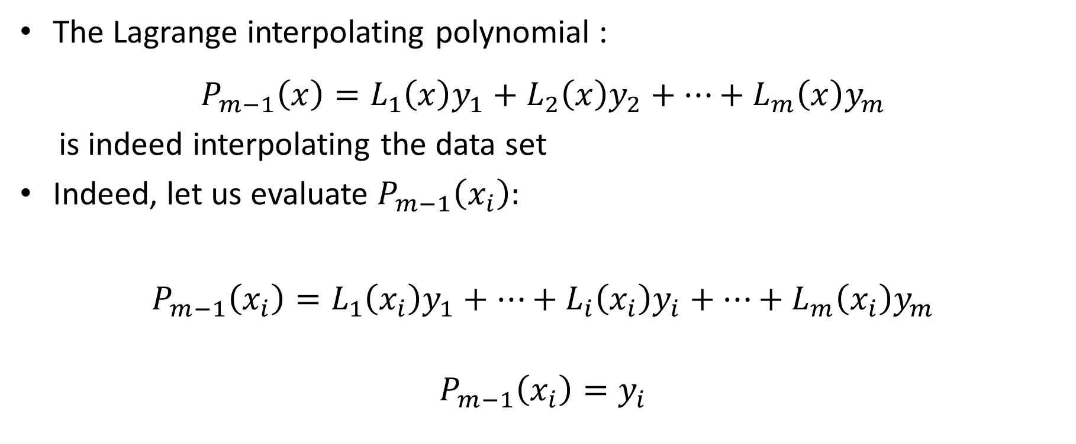



Lagrange Interpolation
The Lagrange interpolating polynomial :
$$P_{m−1}\left(x\right)=L_{1}\left(x\right)y_{1}+L_{2}\left(x\right)y_{2}+…+L_{m}\left(x\right)y_{m}$$
is indeed interpolating the data set
Indeed, let us evaluate $P_{m−1}\left(x_{i}\right):$
$$P_{m−1}\left(x_{i}\right)=L_{1}\left(x_{i}\right)y_{1}+…+L_{i}\left(x_{i}\right)y_{i}+…+L_{m}\left(x_{i}\right)y_{m}$$
$$P_{m−1}\left(x_{i}\right)=y_{i}$$
$$0$$
$$0$$
$$0$$
Notes:
Let us imagine we know these Lagrange polynomials. In fact we will learn in a few minutes how to find them.
We can verify that Pm-1 written as the linear combination of these Lagrange polynomials will indeed interpolate the data points.
For this let us evaluate Pm-1 in the data point xi.
Based on the definition of the Lagrange polynomials, all of them will evaluate to zero expect Li which will evaluate to one
So indeed $P_{m−1}\left(x_{i}\right)=y_{i}$

Slide 5
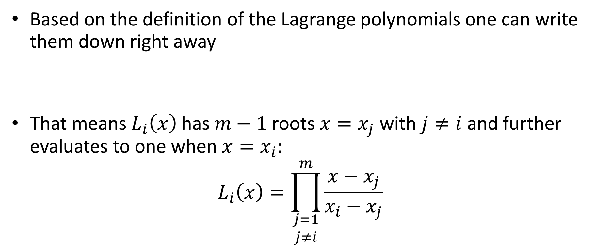
Lagrange Polynomials
Based on the definition of the Lagrange polynomials one can write them down right away
That means $L_{i}\left(x\right)$ has $m−1$ roots $x=x_{j}$ with $j≠i$ and further evaluates to one when $x=x_{i}$:
$$L_{i}\left(x\right)=\prod_{\begin{aligned}j=1 \\ j≠i\end{aligned}}^{m}{\frac{x−x_{j}}{x_{i}−x_{j}}}$$
$$L_{i}\left(x\right)=\left\{\begin{aligned}1, \\ &0, \end{aligned}\right.$$
$$x=x_{i}$$
$$x=x_{j} \text{for} j≠i$$
Notes:
How can we find the Lagrange polynomials.
Based on their definition this is actually quite straight forward
From the definition it follows that Li must have n-1 roots which are x=xj for all data points except the point xi.
Consequently Li(x) will be a product of (x-x1) times (x-x2) etc until (x-xm) excluding the term (x-xi).
The second condition is that when we evaluate Li in xi, we must find one
This condition will be satisfied if we further divide our polynomial by the product of all terms (xi-x1) times (xi-x2) etc until (xi-xn), again skipping the term xi-xi
This let us write down the general formulas for a Lagrange polynomial

Slide 6

Example
Fit the following data points ($m=3$):
with a polynomial
$$P_{2}\left(x\right)=L_{1}\left(x\right)y_{1}+L_{2}\left(x\right)y_{2}+L_{3}\left(x\right)y_{3}$$
$$x_{i}$$ | 1 | 2 | 4
$$y_{i}$$ | 2 | -1 | 5
Notes:
Let us familiarize us with Lagrange interpolation with an example
We consider our data set of three data point
The interpolating polynomial P2 will write as $L_{1}\left(x\right)y_{1}+L_{2}\left(x\right)y_{2}+L_{3}\left(x\right)y_{3}$ with y1 being equal to 2, y2 equal to -1 and y3 equal to 5

Slide 7
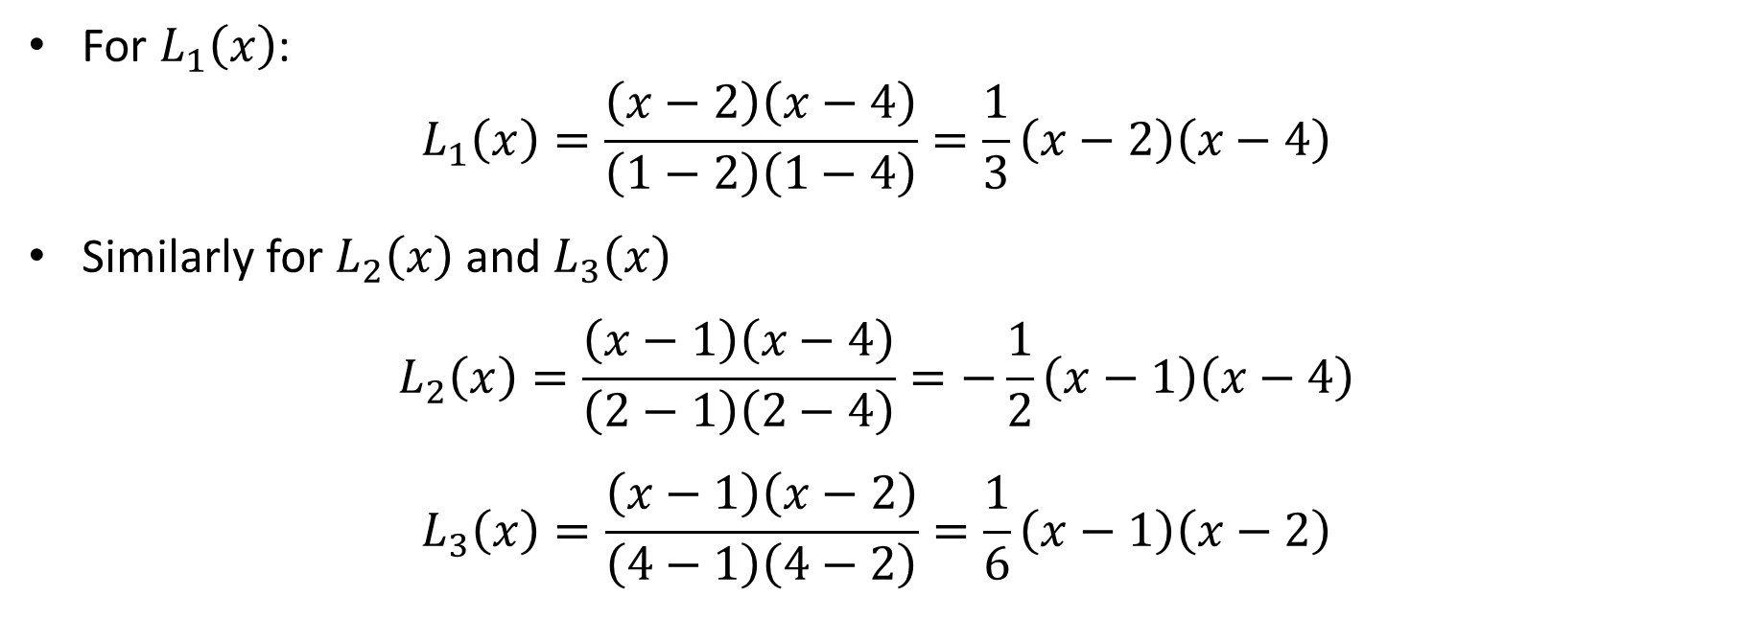
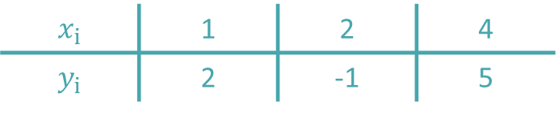
Example
$$x_{i}$$ | 1 | 2 | 4
$$y_{i}$$ | 2 | -1 | 5
For $L_{1}\left(x\right)$:
$$L_{1}\left(x\right)=\frac{\left(x−2\right)\left(x−4\right)}{\left(1−2\right)\left(1−4\right)}=\frac{1}{3}\left(x−2\right)\left(x−4\right)$$
Similarly for $L_{2}\left(x\right)$ and $L_{3}\left(x\right)$
$$L_{2}\left(x\right)=\frac{\left(x−1\right)\left(x−4\right)}{\left(2−1\right)\left(2−4\right)}=−\frac{1}{2}\left(x−1\right)\left(x−4\right)$$
$$L_{3}\left(x\right)=\frac{\left(x−1\right)\left(x−2\right)}{\left(4−1\right)\left(4−2\right)}=\frac{1}{6}\left(x−1\right)\left(x−2\right)$$
Notes:
To finish the problem we need to give the explicit expression of the three Lagrange polynomials L1, L2 and L3.
Let us start with L1.
Form the definition of L1 we know that it must evaluate to zero in x=x2=2 and x=x3=4.
That means L1 has two roots, one in x=2 and one in x=4
Consequently L1 will be something like (x-2)(x-4)
Further it must evaluate to 1 when we evaluate it in x1=1
This happens if we divide our start (x-2)(x-4) of L1 by (1-2)(1-4) which is equal to 3
Consequently L1 is equal to $\frac{1}{3}\left(x−2\right)\left(x−4\right)$
In exactly same way we can build L2 and L3.
Can you find them?
Try it by yourself
The answer you should get are
$$L_{2}\left(x\right)=−\frac{1}{2}\left(x−1\right)\left(x−4\right)$$
$$L_{3}\left(x\right)=\frac{1}{6}\left(x−1\right)\left(x−2\right)$$

Slide 8

Example
Putting all together:
$$P_{2}\left(x\right)={2∙L}_{1}\left(x\right)−L_{2}\left(x\right)y_{2}+5∙L_{3}\left(x\right)$$
with
$$L_{1}\left(x\right)=\frac{1}{3}\left(x−2\right)\left(x−4\right)$$
$$L_{2}\left(x\right)=−\frac{1}{2}\left(x−1\right)\left(x−4\right)$$
$$L_{3}\left(x\right)=\frac{1}{6}\left(x−1\right)\left(x−2\right)$$
Notes:
Putting all together leads us to P2 as displayed on the slide

Slide 9

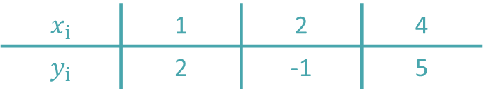


Example
$$x_{i}$$ | 1 | 2 | 4
$$y_{i}$$ | 2 | -1 | 5
We indeed interpolate the data:
$$P_{2}\left(x=1\right)=L_{1}\left(x=1\right)∙2+L_{2}\left(x=1\right)∙\left(−1\right)+L_{3}\left(x=1\right)∙5$$
From which it follows
$$P_{2}\left(x=1\right)=2$$
1
$$0$$
$$0$$
Notes:
Let us verify that P2 is indeed interpolating the data set
For the point x=1, we get
$$P_{2}\left(x=1\right)=L_{1}\left(x=1\right)∙2+L_{2}\left(x=1\right)∙\left(−1\right)+L_{3}\left(x=1\right)∙5$$
But L2 and L3 evaluates to zero in x=1, whereas L1 evaluates to one
Consequently P2(x-1)=2 as it should
Try by yourself the two remaining data points

Slide 10
Example
$$P_{2}\left(x\right)={2∙L}_{1}\left(x\right)−L_{2}\left(x\right)y_{2}+5∙L_{3}\left(x\right)$$
$$y$$
$$x$$
Notes:
A plot of the found interpolating polynomial and the data points confirms that P2 is indeed passing exactly through all data points

Slide 11
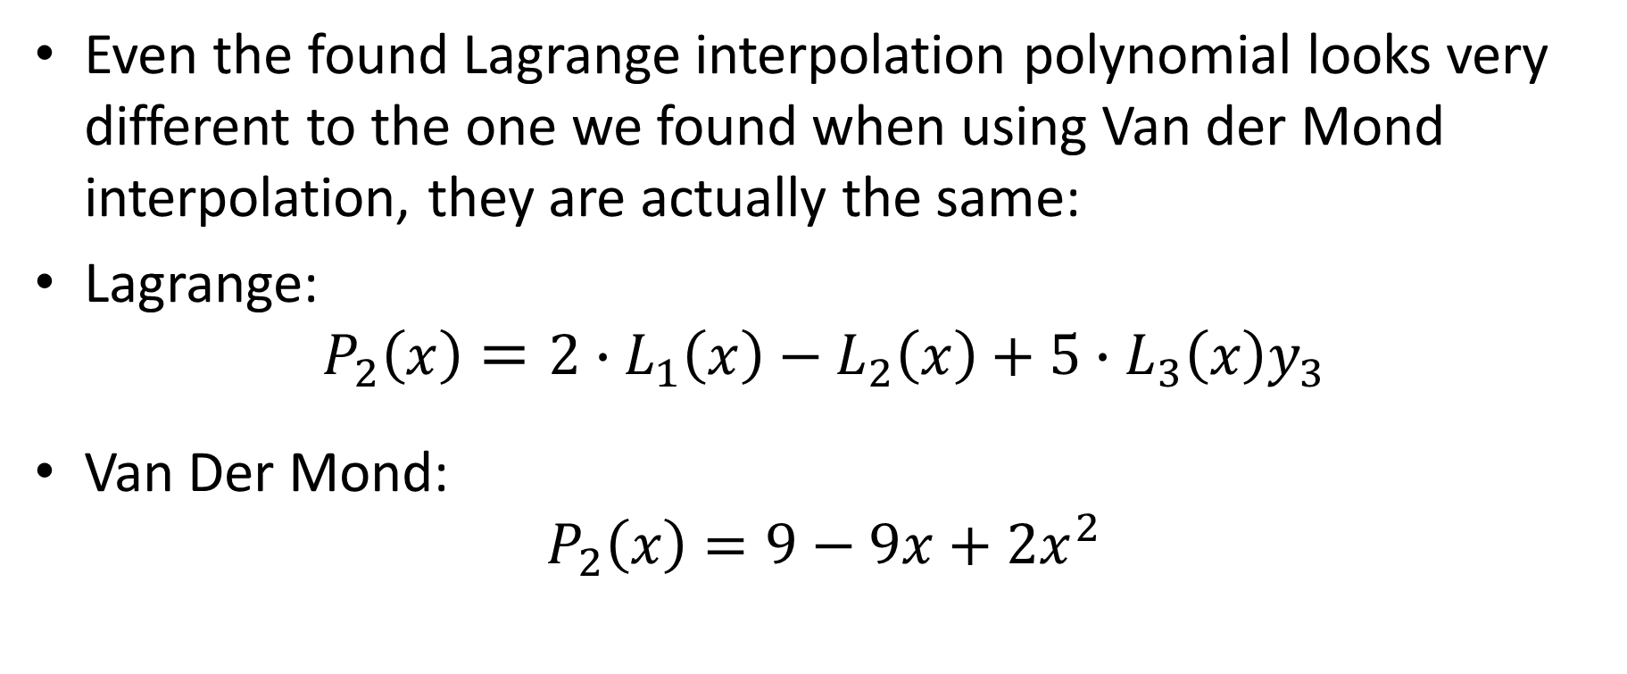
Example
Even the found Lagrange interpolation polynomial looks very different to the one we found when using Van der Mond interpolation, they are actually the same:
Lagrange:
$$P_{2}\left(x\right)={2∙L}_{1}\left(x\right)−L_{2}\left(x\right)+5∙L_{3}\left(x\right)y_{3}$$
Van Der Mond:
$$P_{2}\left(x\right)=9−9x+2x^{2}$$
Notes:
The interpolating polynomial we found by Lagrange and Van der Mond interpolation look very different
But, as it was the case with the Newton interpolating polynomial, they are in fact the same
I invite you to verify that this is indeed the case

Slide 12
Summary
Lagrange interpolation allows the determination of an interpolating polynomial to a given data set
The very particular form of writing down the interpolating polynomial as a linear combination of Lagrange polynomials will have several benefits in coming lectures on numerical integration
Notes:
Let us summarize the key findings
Lagrange interpolation allows the determination of an interpolating polynomial to a given data set
The very particular form of writing down the interpolating polynomial as a linear combination of Lagrange polynomials will have several benefits in coming lectures on numerical integration

